Slide 1
Strengthening the Regional Engagement Role of Universities in Africa and Asia
University of Duhok Presentation
Associate Prof. Dr. Kamal Ketuly
Dr. Sizar Abid Mohammed
Duhok, Kurdistan Region of Iraq
Workshop - Cape Town
11-14th June 2017

Slide 2
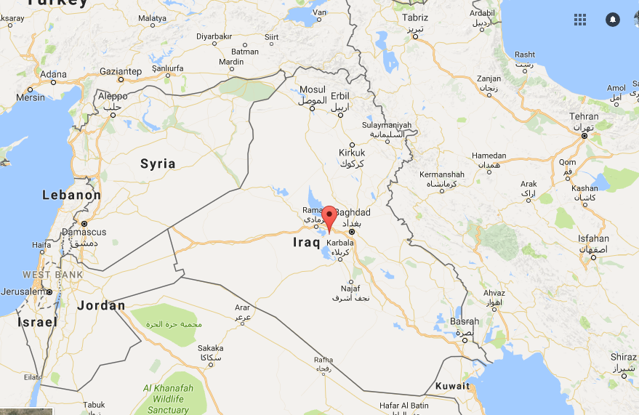
Map of Middle East

Slide 3
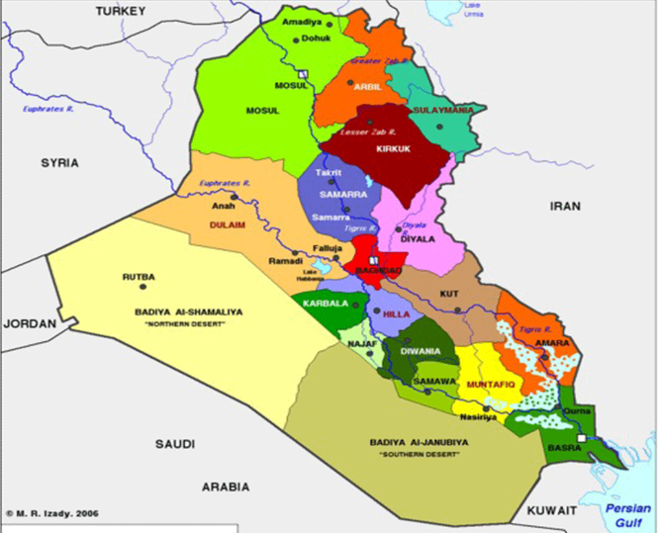
Map of Iraq Euphrates and Tigris

Slide 4
Duhok City
Duhok governorate which lies in the far north-west of Iraq and forms the western governorate in the Iraqi Kurdistan Region. It has a strategic location since it is considered to be a joining point between Syria- Turkey- Iraq.

Slide 5
Duhok city
Duhok governorate is known by its various topography consisting of very high, rough and complex mountains which are part of the chains of Zagros mountains (which form the political border with the Republic of Turkey) and the extended plains enriched with agricultural resources which form the southern area of the governorate. The governorates area is about 1075 Km².

Slide 6
Duhok city
The main urban area is the center of Duhok governorate, defined to be within the boundaries of Duhok municipality. The city is located between 2 mountains (Zawa and White Mountain) and the houses were built at different altitude in the valley. The population of the city is about half million inhabitance.

Slide 7
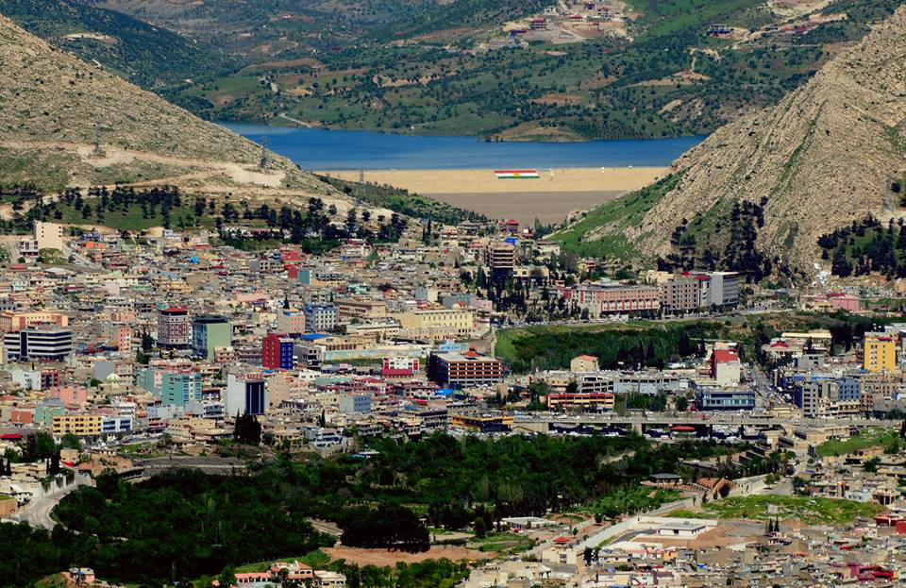

Slide 8
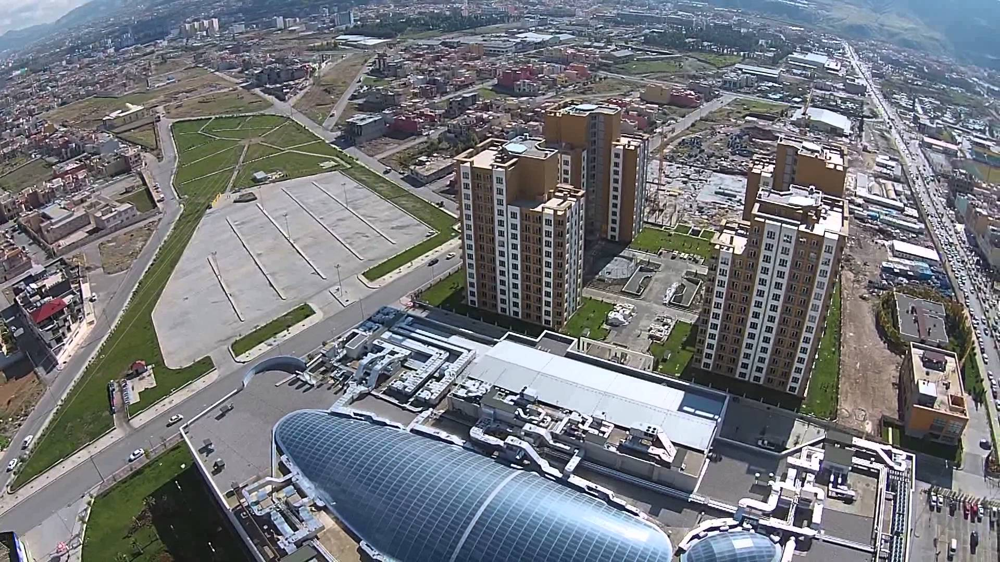

Slide 9
Suburban areas of Duhok City

Slide 10
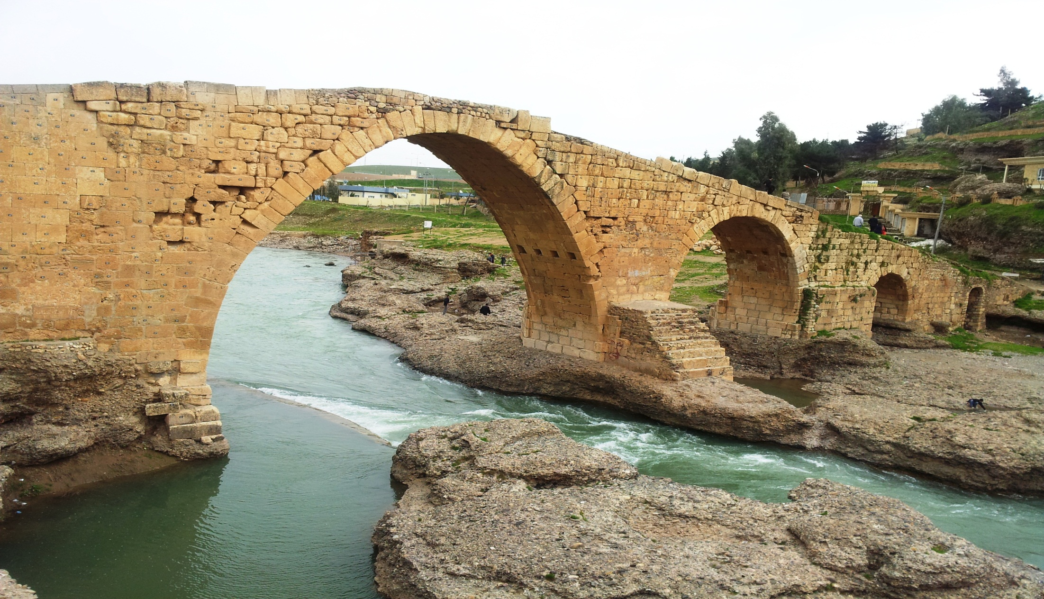
Zakho districts 60 km North West of Duhok at an altitude of 656m

Slide 11
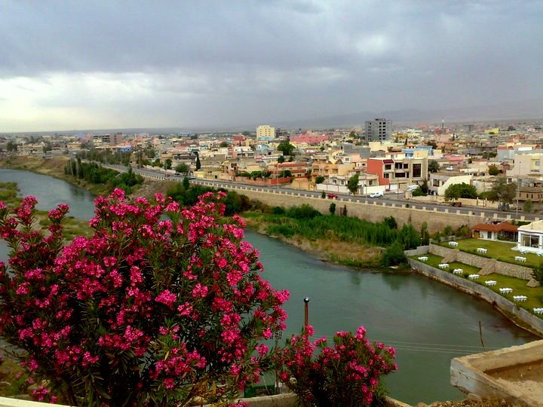
Zakho city and Khabor river

Slide 12
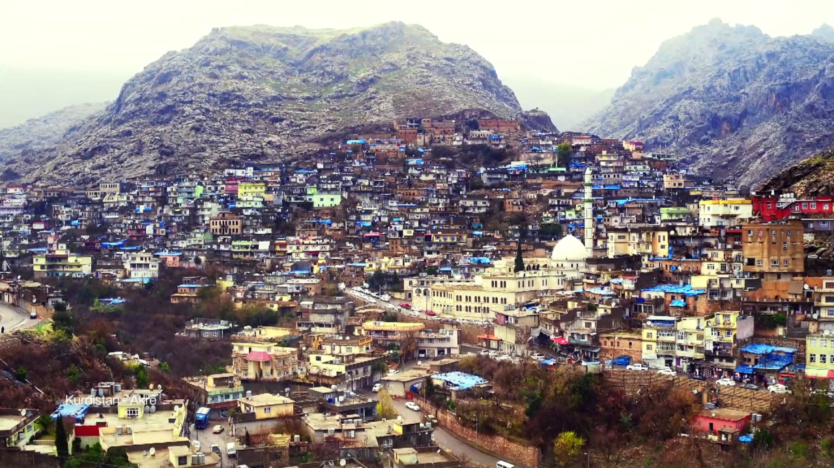
Akre districts 100 km East of Duhok an altitude of 822m,

Slide 13
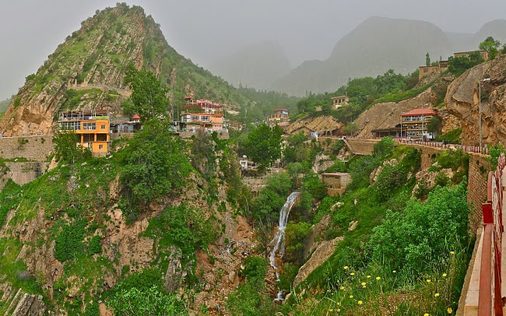
Amedye districts 70 km North of Duhok at a high altitude level of 1254m.

Slide 14
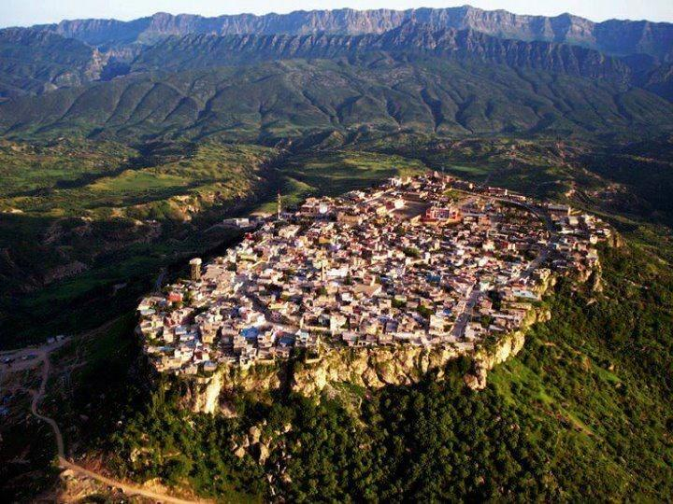
Amedye

Slide 15
Industrial areas
The two main industrial areas, namely Baroshke and Malta were selected. Both are located within the border of the Duhok municipality and include small factories, car repair shops and other industrial related facilities

Slide 16
Agriculture and water resources
Cereals : wheat, barely, oats, Sesame seed, rice, chickpeas and lentil seed etc.
Fruits : Apple and various citrus fruits, fug various type of berries, apricot, prunes, grapes, peach, pear, olives, sunflowers and pomegranates, etc.
Nuts : Almond, walnut and Kezwan.
Tobacco :
A large variety of vegetables:
Large number of water springs, streams, rivers and Dams.

Slide 17
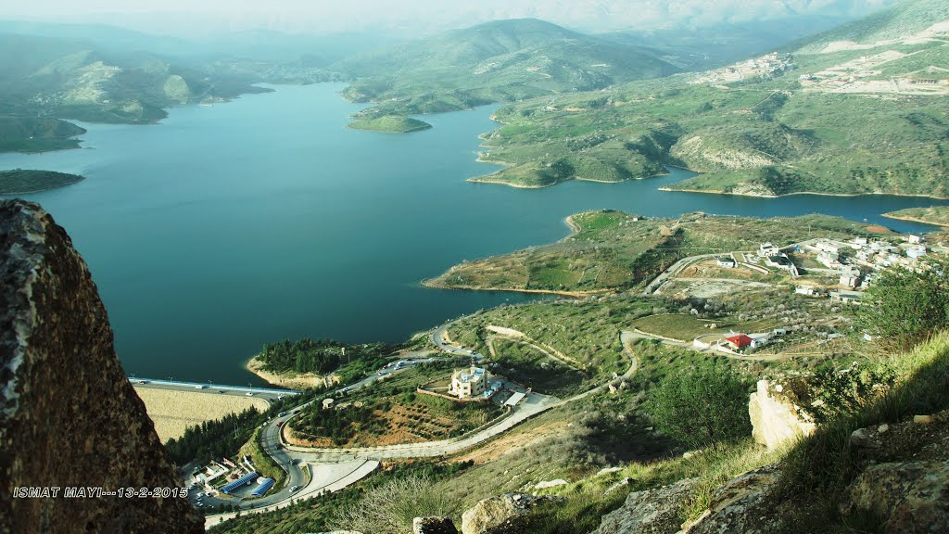

Slide 18
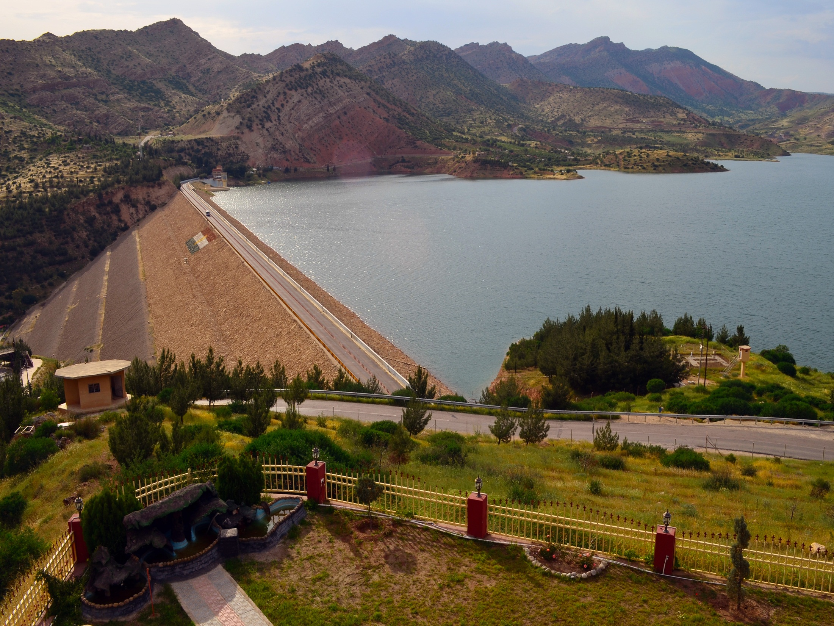

Slide 19
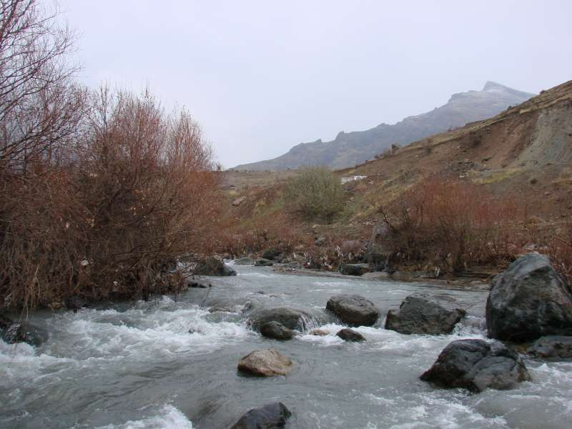
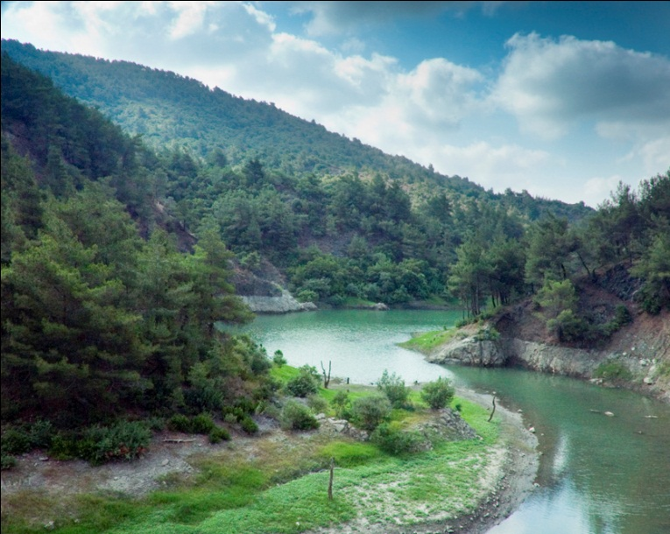
Rivers in Duhok

Slide 20
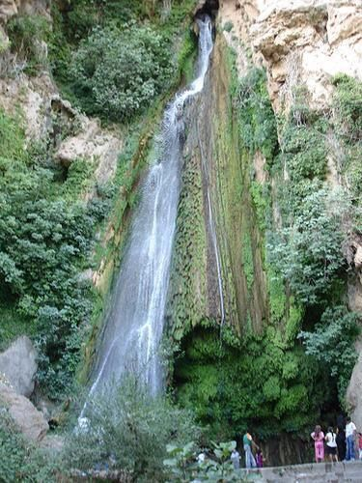
waterfalls in Duhok

Slide 21
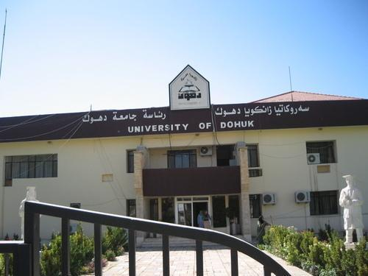
University of Duhok Established 1992-1993

Slide 22
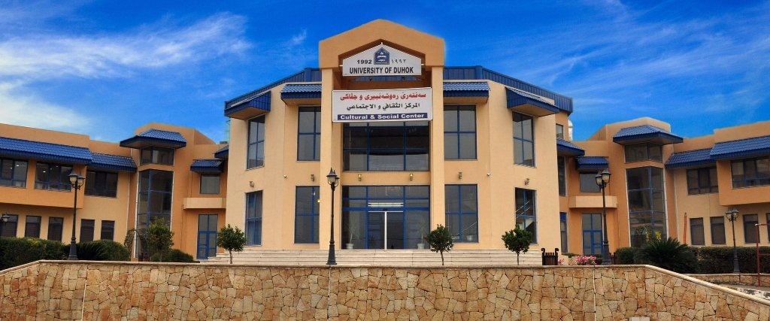
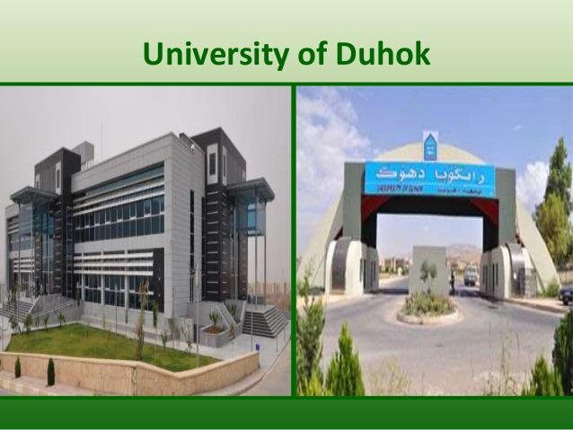

Slide 23
COLLEGES
College of Medicine
College of Agriculture
College of Law and Political Sciences
College of Engineering
College of Humanities
College of Dentistry
College of Pharmacy
College of Veterinary Medicine
College of Administration and Economics
College of Science
College of Basic Education
College of Physical Education
College of Spatial Planning & Applied Science
College of Nursing
College of Education - Akre
College of Health Sciences
College of Basic Education – Amedy
Education for school level and University levels are free

Slide 24
College of Medicine
The College of Medicine is a part of the Division of Health Sciences and a component of the Iraqi Health System in Kurdistan Region and the one of the academic health center.
The college continues to have one of the premier medical education programs in the country. Education and research are the supports of an academic medical center that rest squarely on the foundation of clinical care.

Slide 25
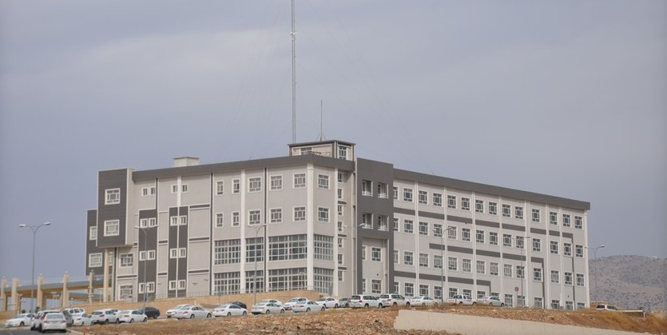
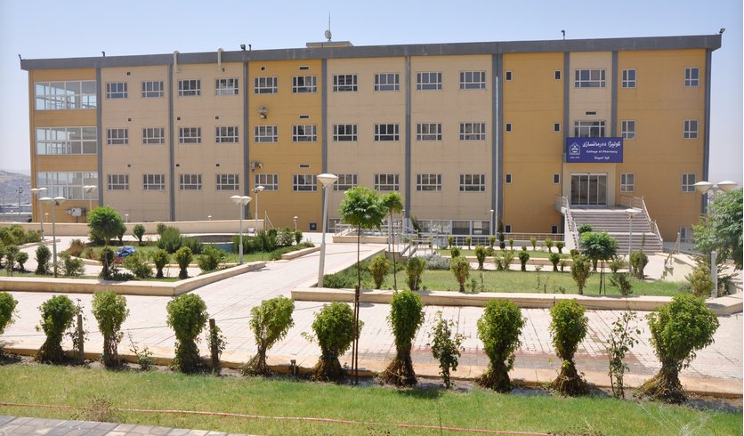

Slide 26
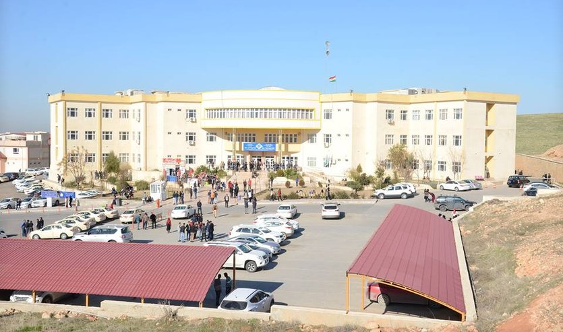
College of Basic Education

Slide 27
The College of basic education had five departments; Kurdish language, English language, Mathematics, Social sciences and Kindergarten. Later on, Two new departments were added to the other five departments; department of Education and Psychology were added in 2010 and the department of special needs which were recently added in 2014.

Slide 28
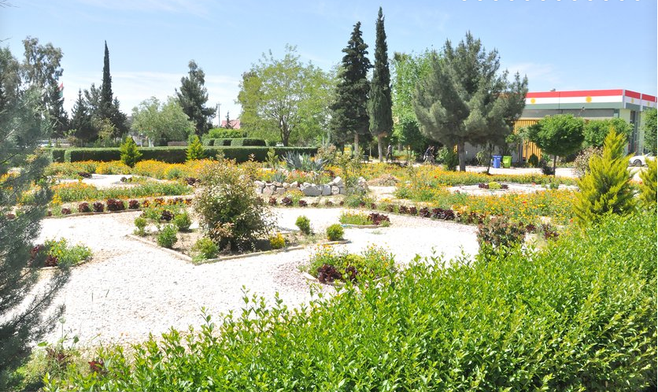
COLLEGE OF AGRICULTURE

Slide 29
The College established in a main plant nursery and cultivated two more orchards – one for olive trees and the other for apricot, peach, and pear trees. Further more the College has several Forestry establishments like forest-tree nursery, metrology station, botanic garden, etc.

Slide 30
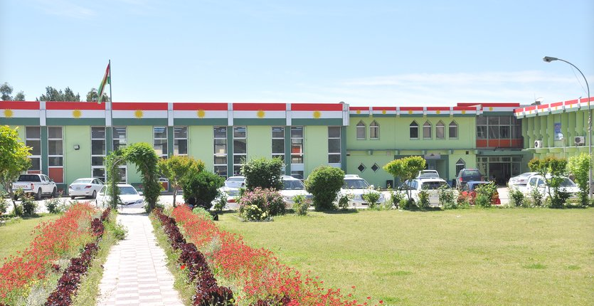

Slide 31
Duhok Polytechnic University

Slide 32
Private Universities American University in Duhok

Slide 33
Economy, industries and employment features
The main economy of the region is depends of the sells of crude petroleum and natural gas production and the industries related to it.
Agriculture products and Tourism.
Due to the current economical crisis and the low price of oil there are a large number of the company's mainly working in the oil sector have been close down and this has created a large impact on the other industries and companies working with and depending on this oil companies for example construction road and highways power generation agriculture and tourism have been badly effected and this have caused a large number of unemployed people , and it has caused a backclash of the employability of the fresh university graduate.

Slide 34
Economic issues
1) The low prices of crude oil and gas.
2) High influx number of refugee's and establishment
of refugee's camps.
3) The high cost of the military war operations in
fighting against terrorists (ISIS), and security

Slide 35
Social issues including health/welfare/education
University of Duhok through colleges of Medicine , Pharmacy, Dentistry and health science are graduating qualified students to work at the varies health departments and hospitals and clinics. The health departments it assist and coordinate with university of Duhok in varies research health protection and other schemes.
The health services and Education are free. etc.

Slide 36
Cultural issues
Duhok city is a mixture of varies historically integrated cultures ethnic and religious cultures, that the mainly Kurdish populations speak the Bahdinani Kurdish dialect and the Assyrian speaks the Aramic language and the Turkman speaks Turkish language and the Arabs.
The religions of Duhok city community are mainly Islamic Christian Yazidi and Kakai with there mosques, churches , monasteries and Yazidi temples. etc

Slide 37
Duhok Multi Cultural City

Slide 38
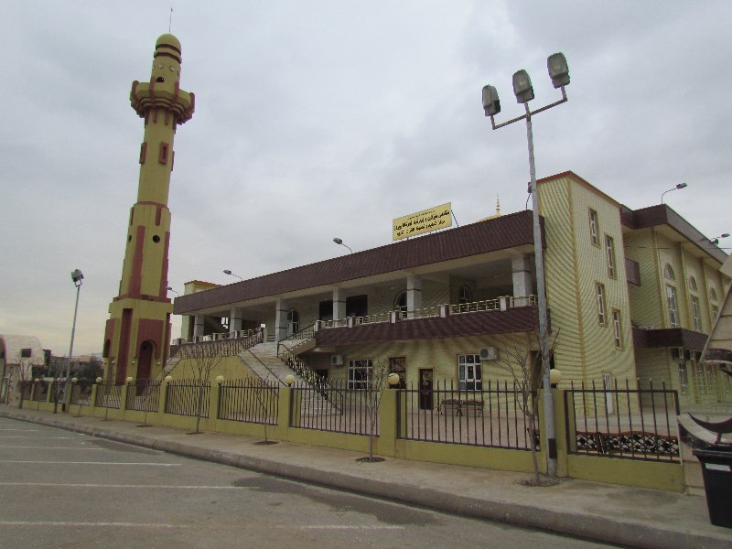
Islamic Mosque in Duhok city

Slide 39
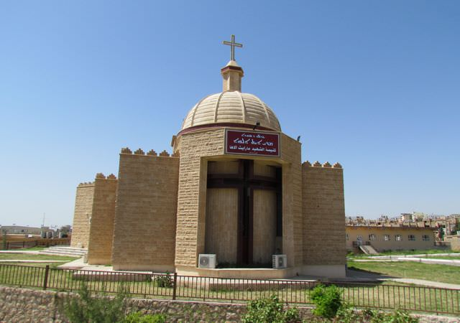
Roman Catholic Church - Duhok

Slide 40
Yazidi Holy Temple Lalish Shekhan - Duhok

Slide 41
Kurdish Jews Celebrating Newroz

Slide 42
Duhok city University Regional Engagement and Development
After ISIS (DAAESH) occupation of Mosul the entire academic and non academic staff of Mosul university have been giving temporary offices within the camps of University of Duhok (UoD). Then they moved to other locations within Duhok.
Many of the students of Mosul University have been accepted (as guest students) to continue with there classes at UoD varies departments and the other Universities.
Many of the internally displace people (IDP) and refugees from Syria have been accepted to continue and register at the UoD and the other mentions University with free education.

Slide 43
Health : The colleges of Medicine, Pharmacy, Dentistry, and Nursing at UoD had to coordinate with Duhok city Health authorities to provide health services and protection for about 850,000 IDP mainly from Mosul and about 250,000 Syrian refugees and actively go in to the war zone and giving health care and treatment for the Kurdish fighter (Peshmerge) and the 1000 of fleeing refugees and still going on.

Slide 44
Education : The college of Basic Education at UoD have come up with the following programs and actively involve in supporting the refugees with their welfare in the following areas:
Training courses for refugees children.
Courses for Trauma and Psychological rehabilitation for the IDP and refugees.
The Psychology academic staff in coordination with some German Universities they go to Germany in a cycle of two staff for three months and they go to the refugees camps their and conduct their rehabilitation program and also they get farther special training courses.
Through German humanitarian agencies once a week a group of undergraduate of Psychology students they go to the IDP and refugees camps in Duhok and they conduct their rehabilitation and psychology programs there.

Slide 45
Agriculture : The college of agriculture at UoD they have special filed programs with the farmers in the development of the agriculture products yield protection of the economical plans ( Fruits, cereals and vegetables etc.) this is including the programs of the uses of insecticides, herbicides and pesticides. And on the soil treatment and water irrigation and fertilizers, Beehives protection and honey production, animal production and health care through their animal production department, economical flowers studies and production through green houses. Environmental protection projects have been established through the newly open department of environment and with coordination with Duhok health and environment authorities.

Slide 46
College of Engineering they coordinate their civil engineering programs with Duhok city authorities in the development of water irrigation water supply from Duhok and Mosul Dams and the rivers purification and distribution systems and waste water treatment, rods and highways projects and modern residential areas.

Slide 47
Duhok Polytechnic University
The newly opened Technical college of petroleum and minerals are conducting research programs and with collaboration with the petroleum companies on the region and with ministry of natural resources on the development of the oil and gas sectors and their related industries.

