Slide 1

University of Duhok
College of Medicine
Dr. Ahmed Mohamed Salih
Head, DMRC

Slide 2

College of Medicine
DMRC was established in Nov 2011, in the faculty of medical sciences (FMS) at that time named as Scientific Research Center (SRC), with one Branch (Hematology Research Center),
It has been equipped and installed and started functioning with kind and appreciated efforts of (Prof. Nassir Allawi) and his team, in February 2012, with an allocated instillation budget of 20 thousand USD by the university president.

Slide 3
Moreover, initial and later funding for the basic requirements was quite restricted, allowing the establishment of just a basic structure molecular laboratory

Slide 4
Researches & Publications (since the starting till 2015)
Zhihua Jiang Z, Luo H, Huang S,….,Al-Allawi NAS,….Chui DHK . The genetic basis of asymptomatic codon 8 frame-shift (HBB:c25_26delAA) β0-thalassaemia homozygotes. Brit. J Haematol2016 ;Epub13 JAN 2016. DOI: 10.1111/bjh.13909. (5yr IF 4.95)
2. Al-AllawiNA, Badi AI, Goran MA, Nerweyi FF, Ballo HM, Al-MzuryNT.The Contributions of Thrombophilic Mutations to Genetic Susceptibility to Deep Venous Thrombosis in Iraqi Patients.Genet Test Mol Biomarkers. 2015; 19(9):500-4 (5 yr IF 1.34)
3. Al-MousawiMMN, Al-Allawi NAS, AlnaqshabandiR. Predictors of Red Cell Alloimmunization in Kurdish Multi Transfused Patients with Hemoglobinopathies in Iraq. Hemoglobin 2015 39(6):423-6. (5 yr IF 1.06)
4. Shamoon RP, Al-Allawi NA, Cappellini MD, Pierro E, Brancaleoni V, Granata F. Molecular Basis of β-thalassemia intermedia in Erbil Province of Iraqi Kurdistan. Hemoglobin 2015 ; issue 3; vol 39; 178-83 (5 year IF 1.06)
5. Eissa AA, Kashmoola MA, Atroshi SD, Al-AllawiNA.Molecular characterization of β-thalassemia in Nineveh province illustrates the relative heterogeneity of Mutation Distributions in Northern Iraq. Indian J Hematology and Blood Transfusion 2015 Jun; issue 2; vol 31; 213-7.(5 year IF 0.39)
6. Al-Allawi NA, Puehringwe H, Raheem RA, Oberkanins C. Genetic Modifiers in β-thalassemia intermedia: A study on 102 Iraqi Arab patients. Genet Test Mol Biomarkers 2015 May; issue 5 : volume 19: 242-7 (5 year IF 1.34).

Slide 5
Researches & Publications (since the starting till 2015)
7. Kashmoola MA, Eissa AA, Al-Takay DT, Al-Allawi NA. Molecular characterization of G6PD deficient variants in Nineveh Province, Northwestern Iraq. Indian J Hematology and Blood Transfsuion 2015 March; issue 1; vol 31: pp 133-6. (5 year IF 0.39)
8. Al-Allawi NA, Al-Doski AA, Markous RS, Mohamad AKA, Eissa AA, Badi AI, Asmaro RR, Hamamy H. Premarital Screening for hemoglobinopathies: experience of a single center in Kurdistan, Iraq. Public Health Genomics 2015 Feb; issue 2; volume 18: 97-103. (5 year IF 2.2)
9. Hamamy H, Makrythanasis P, Al-Allawi N, Muhsin AA, Antonarakis SE (2014) Recessive thrombocytopenia likely due to a homozygous pathogenic variant in the FYB gene: case report. BMC Medical genetics .2014 Dec 17;15:135. doi: 10.1186/s12881-014-0135-0.(5 yr IF 2.54)
10. Makrythanasis P, Nelis M, Santoni FA, Guipponi M, Vannier A, Béna F, Gimelli S, Stathaki E, Temtamy S, Mégarbané A, Masri A, Aglan MS, Zaki MS, Bottani A, Fokstuen S, Gwanmesia L, Aliferis K, Bustamante Eduardo M, Stamoulis G, Psoni S, Kitsiou-Tzeli S, Fryssira H, Kanavakis E, Al-Allawi N, Sefiani A, Al Hait S, Elalaoui SC, Jalkh N, Al-Gazali L, Al-Jasmi F, Bouhamed HC, Abdalla E, Cooper DN, Hamamy H, Antonarakis SE. Diagnostic exome sequencing to elucidate the genetic basis of likely recessive disorders in consanguineous families.Hum Mutat. 2014 Oct;35(10):1203-10(5 yr IF 5.76)

Slide 6
Researches & Publications (since the starting till 2015)
11. Ali MD, Badi AI, Al-Zebari SS, Al-Allawi NA. Response to Tyrosine Kinase Inhibitors in Chronic Myeloid Leukemia : Experience from a West Asian Developing Country. Int. J. Hematology2014 Sept; issue 3; vol 100: 274-9. (5 yr IF 1.68)
12. Al-Allawi NA, Jalal SD, Mohammad AM, et al. β-thalassemiaIntermedia in Northern Iraq: A single center experience.BioMed Research International.2014 Feb ; 2014:262853. doi: 10.1155/2014/262853..( 5 year IF 2.69)
13. Novarino G, Fenstermaker AG, Zaki MS, ……,Al-Allawi N,……Glesson J (2014). Exome Sequencing Links Corticospinal motor neuron disease to common neurodegenerative disorders. Science 343, 506-511.(5 yr IF 32.45).
14. Othman AA, Eissa AA, Markous RD, Ahmed BD, Al-Allawi NA (2014). Hepatitis C Virus genotypes in Multiply transfused Haemoglobinopathy patients in Northern Iraq.Asian J Transfusion Science.8(1): 32-34.
15. Al-Allawi NA, JalalSD, Ahmed NH, et al (2013). The first five years of a preventive programme for haemoglobinopthies in Northern Iraq. J Med Screen, 20(4): 171-6. (5 year IF 2.55)

Slide 7
Researches & Publications (since the starting till 2015)
16. Al-Allawi N, Al-Musawi B, Badi A, Jalal S (2013). The Spectrum of β-thalassemia mutations in Baghdad-Central Iraq.Hemoglobin. 37 (5): 444-453. (5 yr IF 1.06)
17. Hamamy H, Al-Allawi N (2013). The Epidemiology of Haemoglobinopathies in Arab Countries.J Community Genetics.4(2):147-167.
18. Al-Allawi N, Jalal S, Rasheed N, et al (2013). The spectrum of Alpha thalassemia mutations in the Kurdish population of Northeastern Iraq.Hemoglobin.37 (1): 56-64. (5 yr IF 1.06)
19.Al-Allawi NA, Shamdeen MY, Mohammed QO, Ahmed AS(2014). Activated protein C resistance and antiphospholipid antibodies in recurrent fetal loss: experience of a single referral center in northern Iraq. Indian J. Haematol and blood transf 2014
30(4):364-9. (5 yr IF 0.39)
20. Al-AllawiN, Jalal S, Nerwey F, et al (2012) Sickle Cell Disease in the Kurdish population of Northern Iraq.Hemoglobin36(4):333-42.(5 yr IF 1.06)

Slide 8
Degree Researches (M.Sc., Ph.D., Board)
More than 33 degree projects are conducted
Silent 1131 mutation in G6PD non-deficient males in Duhok. Board thesis.
Researcher :DrSalarAyoub, DrAdilabuZaidEissa, DrNasir Al-Allawi, Project concluded late 2013, extended and now submitted for publication.
Factor V Leiden in Deep Venous thrombosis in Duhok. Board thesis.Researcher :DrAmeerBadi, DrNasir Al-AllawiConcluded early 2013 and submitted and
accepted. Later was extended and published in an international journal
Spectrum of HCV genotypes among multiply transfused patients with Hemoglobinopathies. Master thesis, extended. AdilAbdulsalam, DrAdil Abu Zaid, DrNasir Al-Allawi, DrRajiMarkous .Concluded in Sept 2012 , and published in peer reviewed International Journal in Jan 2014.
Molecular basis and the role of QTLs in Thalintermedia in Iraq. Researchers: Nasir Al-allawi, Dr Helene Puehringer (Austria), Dr Christine Oberkanins (Austria), DrRazziqaAbdulrahem.

Slide 9
Degree Researches (M.Sc., Ph.D., Board)
A novel Method for treating Dentin Hypersensitivity by using Nano-flour-hydoxyapetitie and NdiXag Laser. PhD Dentistry (Part of the work done at the center), Researcher: Saeed Ali Mohammed, Khulood Al-Sofi, RaadNiamaDayem, The work at the center concluded Mid 2013 and PhD obtained.
A novel Nano-calicum polyurethane -Base root canal obturation material. PhD project. (part of the work done at the cneter), Researcher :DrBaharSelivany, Dr Salem Al-Sammarai, DrRaadNeemaDayem. The work at the center concluded, PhD obtained.
Methylene tetrahydrofolatereductase C677T in Deep Venous thrombosis. Researcher :DrNasir Al-Allawi, Project just concluded, and now published as part of a broader paper in an international Journal.

Slide 10
In 2015, the name has been changed in (Duhok Medical research center, DMRC),
It has been expanded to cover more disciplines

Slide 11
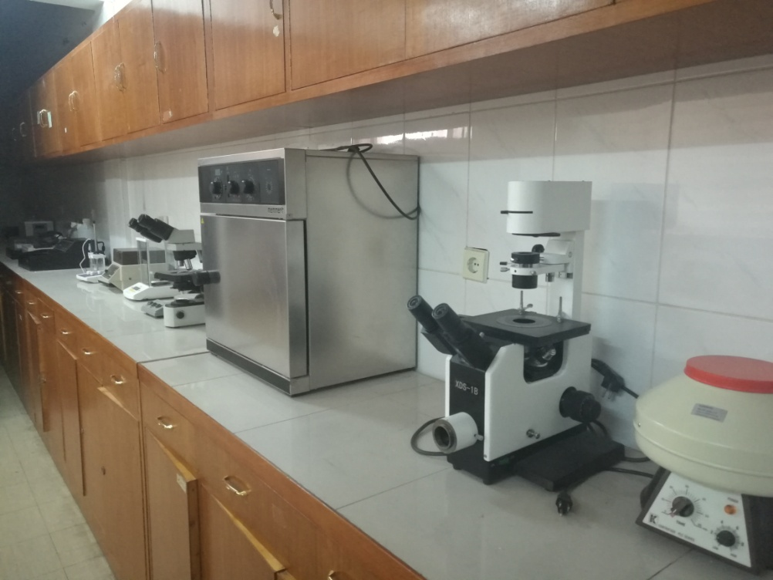
Three units are added in 2016:
1- Genotoxicity Unit:
(DNA damage studies, Comet assay)
Running by:
Dr. Hishyar Azo

Slide 12
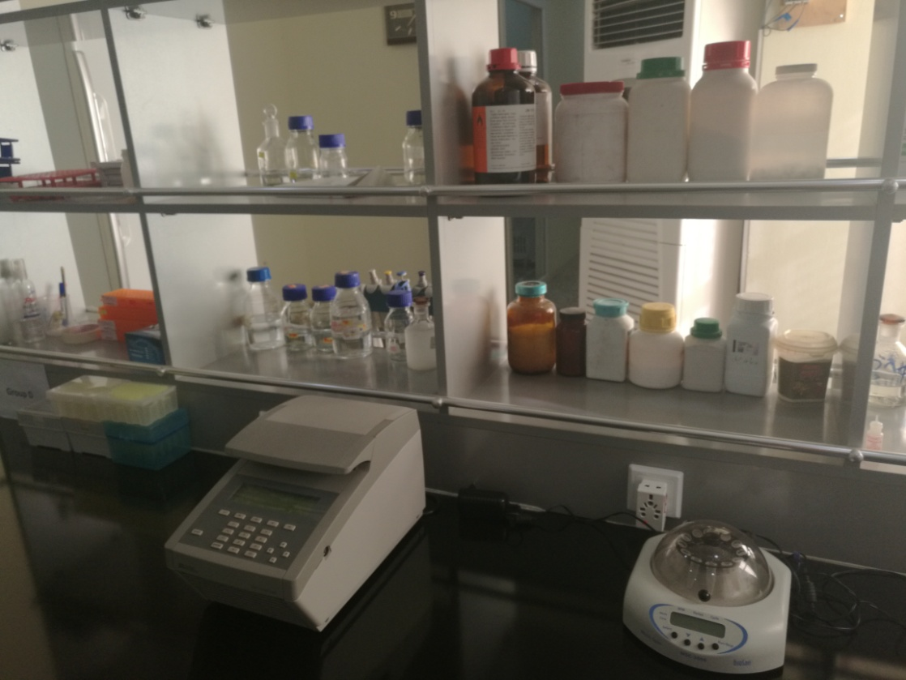
2- Molecular Biology & PCR Unit:
Running by Dr. Aleen Sardar Zuhdi

Slide 13
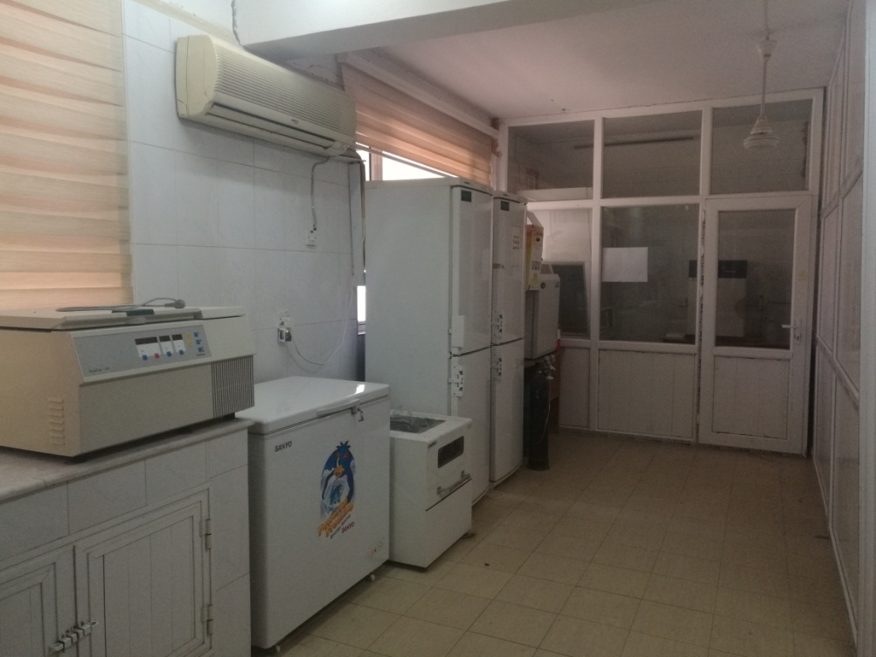
3- Tissue Culture Unit:
Running by Miss Haliz Saddiq

Slide 14
The Coordinator of the DMRC is :
Mrs. Soleen Sardar Zuhdi
(Managing the whole research processes and follow-up, month and annual reporting)

Slide 15
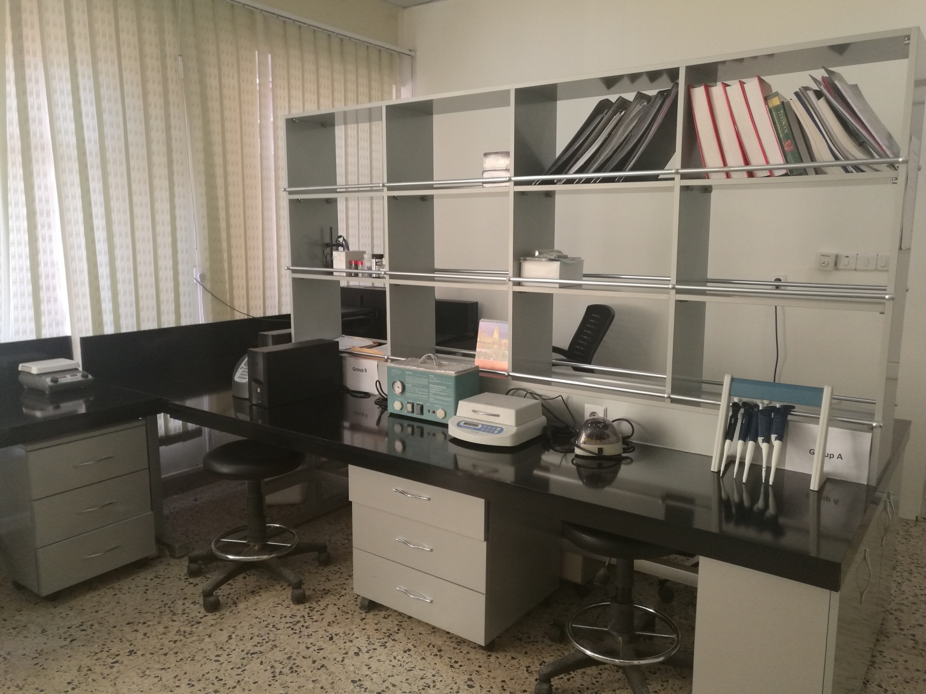

Slide 16
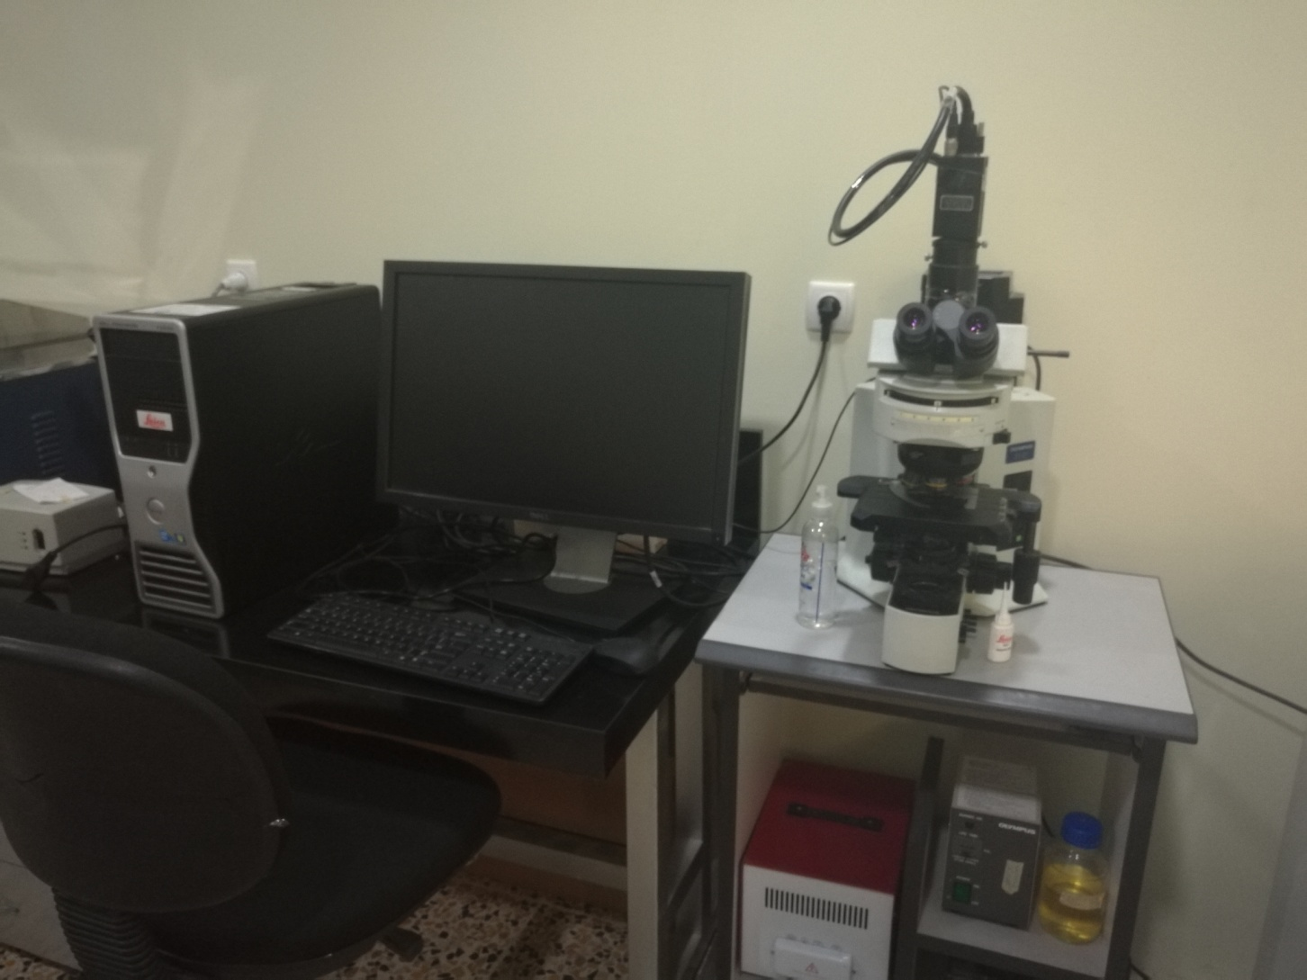

Slide 17
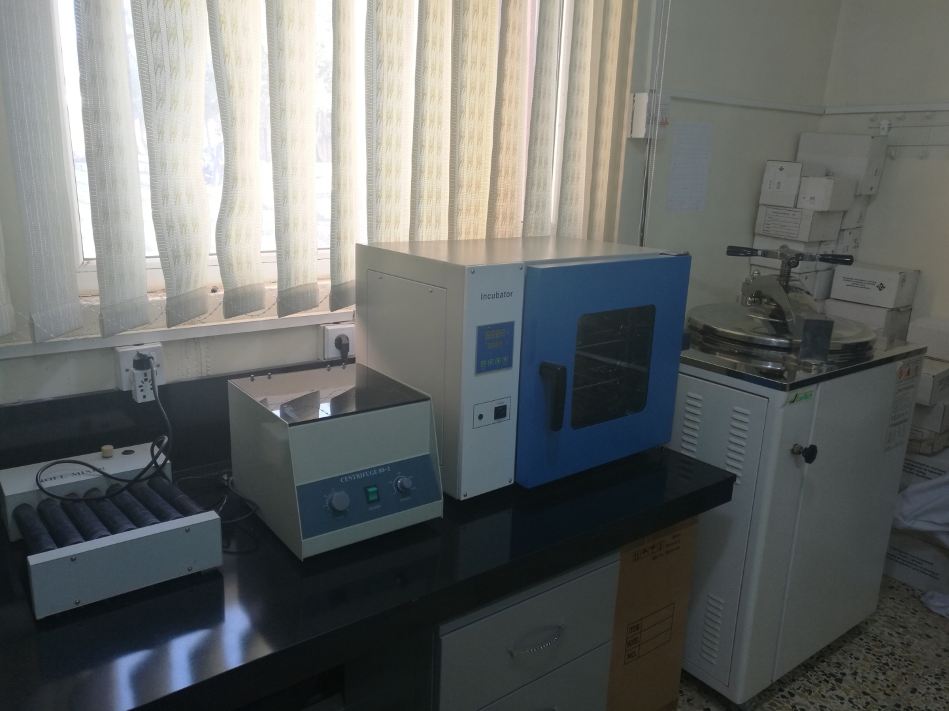

Slide 18
Ongoing Researches (2015 – 2016)
Anti-leukemic effect of polyphenol that extracted from grape seeds in Duhok
governorate (M.Sc. project)
- The association between histological characterization and chromosomal
aberration in bladder cancer (M.Sc. project).
- MTHFR mutation among NTD neonates in Duhok city (M.Sc. project).
- MTHFR gene mutations association with thyroid cancer Duhok city.
- The profile of CFH gene mutations among Behcet’s disease patients in Duhok
city.

Slide 19
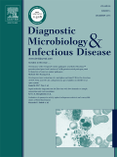
Accepted in Process
Attribution of Helicobacter pylori and Serum Vitamin B12 Level with Recurrent Aphthous Stomatitis in Duhok, Iraq
Five years Impact Factor: 2.429
2015 Impact Factor: 2.45
(Thomson Reuters Citations)

Slide 20
2016, Nine Projects are submitted to DMRC the staff of the college & approved :
Association of SNPs of Complement Factor H gene with Recurrent Aphthus Stomatitis.
Authors: Dr. Ahmed Mohamed Salih, Assistant Prof
HalizSaddiqHasan, Assistant lecturer
SoleenSardarZuhdi, Assistant lecturer

Slide 21
The prevalence ofH. pylori infection associated with non- Hodgkin lymphoma in Duhok.
Authors: Dr. ZAki Ali Mohammed, Lecturer
Dr. MuayadAghaliMirza, Assistant Prof

Slide 22
The potential role of human anti- chimeric IgG antibodies to rituximab in treatment resistance in non- Hodgkin lymphoma patients.
Authors: Dr. Zaki Ali Mohammed, lecturer
Dr. AleenSardarZuhdi, assistant lecturer

Slide 23
The impact of neurokinin B (TAC3) andneutokinin B receptor (TACR3) gene polymorphism on unexplained recurrent pregnancy loss in Duhok.
Authors: Dr. AlaayosifMahmood, lecturer
SoleenSardarZuhdi, assistant lecturer

Slide 24
S100- A4 protein profile in HCV seropositive patients in Duhok city.
Author: Dr. AleenSardarZuhdi, assistant lecturer

Slide 25
What can DMRC offers
Have an Idea ???
(Design it as a research project)
Establish a team that can help you in collecting, processing and reporting your medical samples
Provide you with facilities, equipments and experimental experience to go a head with your research.
The team collectively, can write down the research data as an article and send it for publication

Slide 26
Thanks For Your Attention
Your Comments are Welcomed

