Slide 1
Bureau of Educational & Cultural Affairs
U.S. Department of State
Public Affairs Section
U.S. Embassy Baghdad, Iraq

Slide 2
November 28, 2016
FULBRIGHT VISITING SCHOLAR PROGRAM FOR IRAQ
Presented By: James H Haido, PhD
University of Duhok
Email: james.haido@uod.ac

Slide 3
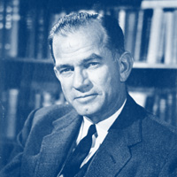
Senator J. William Fulbright (1905-1995)
“International education exchange is the most significant current project designed to continue the process of humanizing mankind to the point, we would hope, that nations can learn to live in peace.”
Established 1946
Sends U.S. academics and professionals overseas and brings scholars and professionals from abroad to the U.S.
Sponsored by U.S. Department of State’s Bureau of Educational and Cultural Affairs
Administered by the Institute of International Education’s Council for International Exchange of Scholars (CIES)

Slide 4
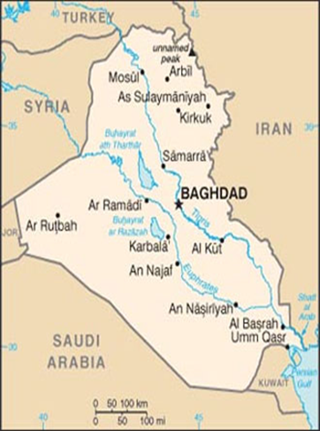
Fulbright Visiting Scholar Program Overview
Ten-week, non-degree professional faculty development program for junior Iraqi scholars.
Five discipline based cohorts will be hosted at U.S. universities.
This is not a research program, although participants will be introduced to research methodology.

Slide 5
Benefits to Iraqi Scholars
Build higher education capacity in Iraq
Develop a network of American colleagues and opportunities for future collaboration
Improve teaching methods and develop new curricula
Promote mutual understanding between Iraqis and Americans
Join an elite group of over 300,000 Fulbright alumni
Fulbright is one of the most prestigious and widely recognized international academic and cultural exchange programs in the world.

Slide 6
Eligibility Requirements
Resident and citizen of Iraq
Full-time Iraqi university faculty member
Meet one of the following education/experience requirements:
Minimum of an MA/MS degree with at least five years of university-level teaching experience
MA/MS, currently enrolled in a PhD program, with at least three years of university-level lecturing experience
PhD and no more than five years of university-level teaching experience.

Slide 7
Eligibility Requirements (Continued)
Fluent in spoken and written English (recommended minimum TOEFL score of 550)
Commitment to classroom teaching and desire to strengthen teaching and leadership skills
Academic focus in one of program’s academic disciplines
Available to travel to U.S. and participate for duration of grant period
Committed to returning to Iraq to share knowledge and skills with students, colleagues, and university administrators
.

Slide 8
Cohorts & Relevant Fields
Law & Human Rights– Law and social studies.
TEFL/Linguistics – Applied linguistics and teaching of English as a foreign or second language.
Business Administration & Global Entrepreneurship

Slide 9
Cohorts & Relevant Fields (Continued)
Science & Technology – Biology, chemistry, physics, mathematics, computer science, information science, and GIS.
Engineering – Mechanical, computer, civil, chemical, electrical, industrial, materials, and systems engineering.

Slide 10
Program Timeline & Duration
Program Dates: June 30 – September 8, 2017
Ten weeks at U.S. host institution:
Observe classes, attend seminars, and visit labs
Learn new teaching and research methods
Develop linkages with American faculty
Pursue self-directed projects; examples:
Research articles or course material for classes
Explore American history
Learn to use new lab instruments

Slide 11
Components & Activities
Explore new approaches to teaching and curricula
Work with a faculty mentor at host university
Be introduced to teaching methodology, pedagogy, technology in the classroom, curriculum development, assessment strategies, educational leadership, and academic support structures
Receive an overview of U.S. higher education and administration

Slide 12
Components & Activities (Continued)
Build research capacity through mentoring and exposure to research methodology and infrastructure
Visit laboratories and libraries
Serve as a resource on Iraqi history, culture, and higher education
Connect with the local community

Slide 13
Grantee Support
Monthly stipend & travel allowance
Professional development funds
Round-trip airfare from Iraq to the United States
Accident and sickness medical coverage
Furnished, apartment-style accommodations

Slide 14
Application Process
Application and supporting documents submitted online at: https://apply.embark.com/student/fulbright/scholars/30/
Supporting documents
Two letters of recommendation
CV
Statement of purpose
Scanned passport copy
Please review application instructions
Complete applications due December 15, 2016

Slide 15
Grantee Selection
Open, merit-based competition by Public Affairs Section of U.S. Embassy in Baghdad
Nominated finalists further reviewed by Fulbright Program Office in Washington, D.C.
Final selection made in February 2017
Selected candidates must receive medical clearance, Fulbright Foreign Scholarship Board approval, and be eligible to receive a J-1 visa before grantee status is conferred.

Slide 16
Frequently Asked Questions
May I bring my spouse or child with me to U.S.?
No, grantees may not bring any accompanying dependents.
Will I be able to enroll in English courses on campus?
ESL courses are not provided through the program. All grantees must have sufficient written and oral English proficiency.
Will there be any orientation after I arrive in the U.S.?
Your host institution will provide a comprehensive orientation upon arrival. The Council for International Exchange of Scholars (CIES) will also provide a one-day arrival orientation session.

Slide 17
More Questions?
Please direct all questions regarding the Fulbright Visiting Scholar Program for Iraq to:
Iraqfulbrightscholar@iie.org.

